Slide 1
ENGLISH EXAM
UNIT 5

Slide 2
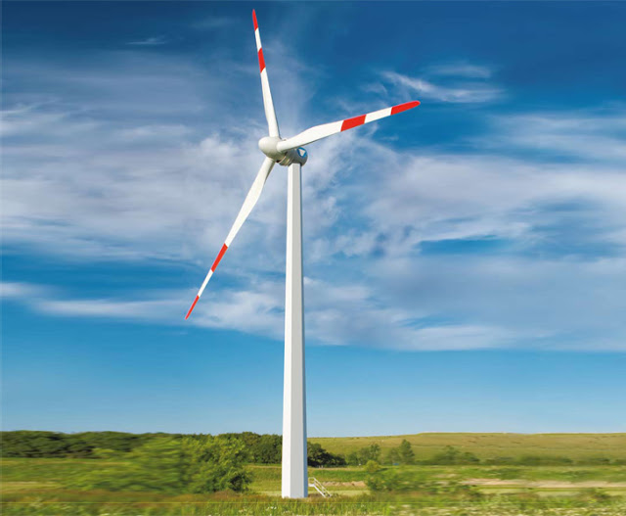
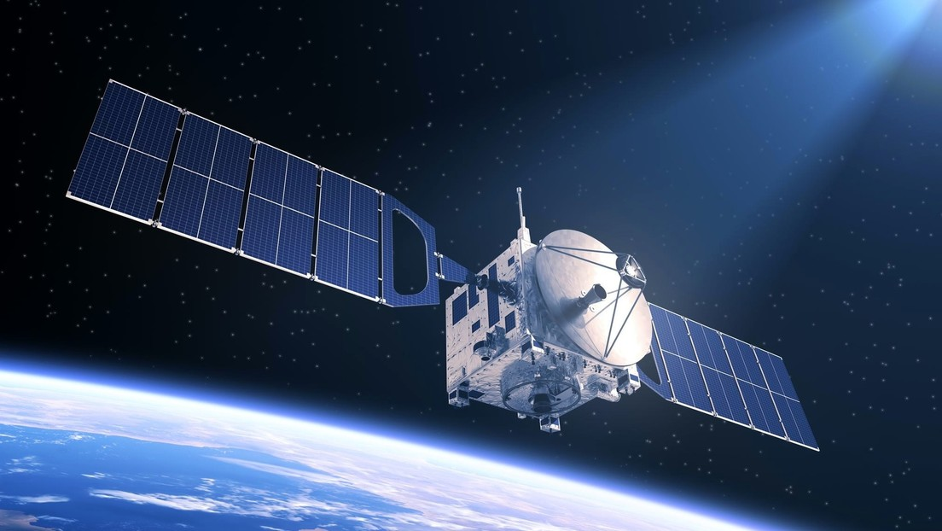
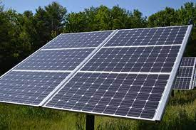
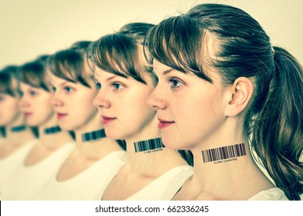
VOCABULARY: science
DNA: adn
Clone: clon
Genetically modified crops: cultivos genéticamente modificados
Spacecraft: astronave
Satellite: satélite
Wind turbine: aerogenerador
Solar panel: panel solar
Battery: batería
Cure: cura
Disease: enfermedad
Vaccine: vacuna
Planet: planeta

Slide 3
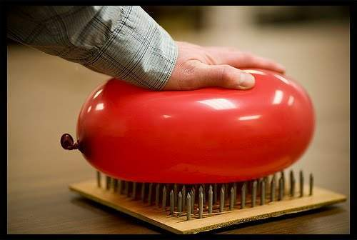
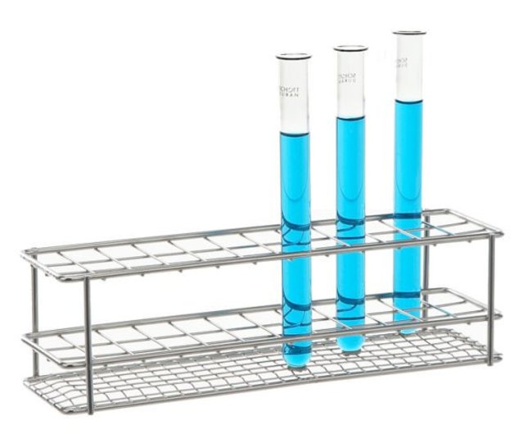
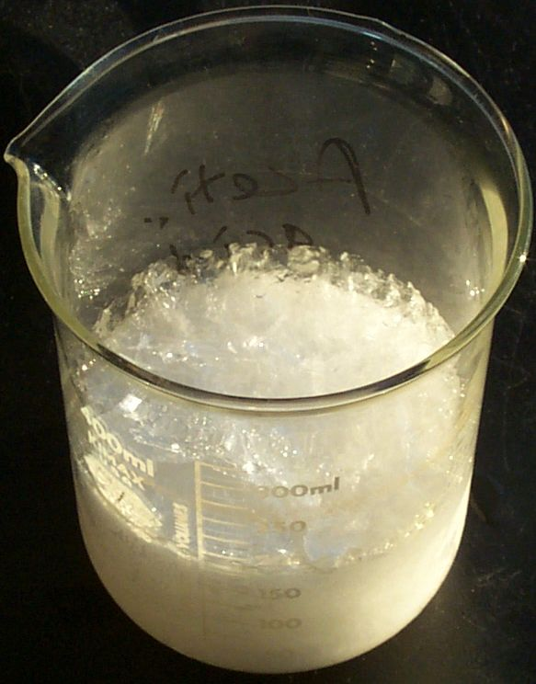
VOCABULARY: science in the classroom
Laboratory: laboratorio
Test tube: tubo de ensayo
Thermometer: termómetro
Explosion: explosión
Pressure: presión
Jug: jarra
Gas: gas
Liquid: líquido
Gravity: gravedad
Temperature: temperatura
Air: aire
Bubbles: burbujas
Acid: ácido
Chemical reaction: reacción química

Slide 4
Will
Can → Be able to
Won’t
GRAMMAR: future
affirmative | short form
I/You/We/They/He/She/It will have vitamines. | I/You/We/They/He/She/It’ll have vitamines.
Subject + will + verb + complements
negative | short form
I/You/We/They/He/She/It will not have vitamines. | I/You/We/They/He/She/It won’t have vitamines.
Subject + won’t + verb + complements
questions
Will I/You/We/They/He/She/It have vitamines?
Will + subject + verb + complements + ?
short answers
Yes, I/You/We/They/He/She/It will.
No, I/You/We/They/He/She/It won’t.

Slide 5
GRAMMAR: first conditional
situation | result
IF we use too much water for washing, | we won’t have enough to drink!
IF + subject + present verb + complements + , | subject + future verb + complements
result | situation
We won’t have enough to drink | IF we use too much water for washing.
subject + future verb + complements | IF + subject + present verb + complements + ,
questions
IF we use too much water for washing, | will we have enough to drink?
IF + subject + present verb + complements + , | will + subject + verb + complements + ?
will we have enough to drink | IF we use too much water for washing?
will + subject + verb + complements | IF + subject + present verb + complements + ?

