Slide 1
Unit 4: Life on earth
GRAMMAR
Comparatives & superlatives
a/an, some, any
Much, many, a lot of
as...as
VOCABULARY
Geography and landscape
animals

Slide 2
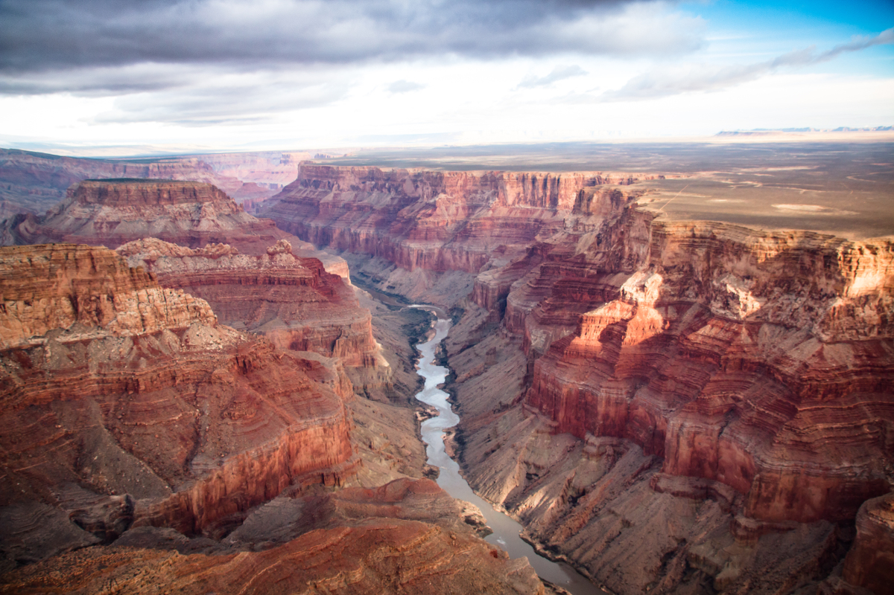
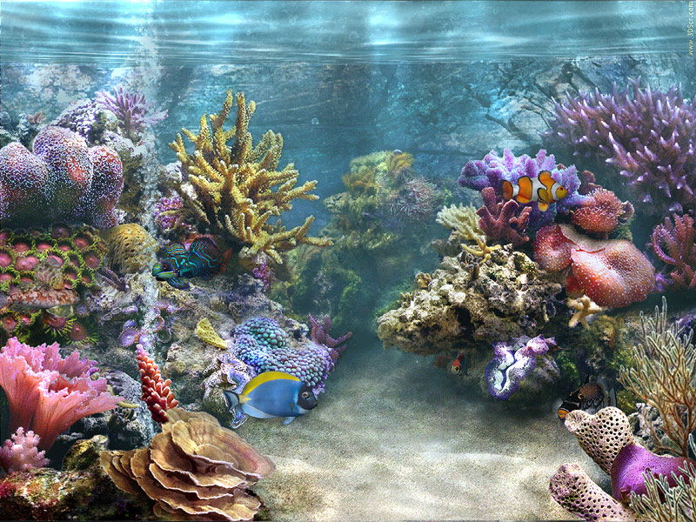
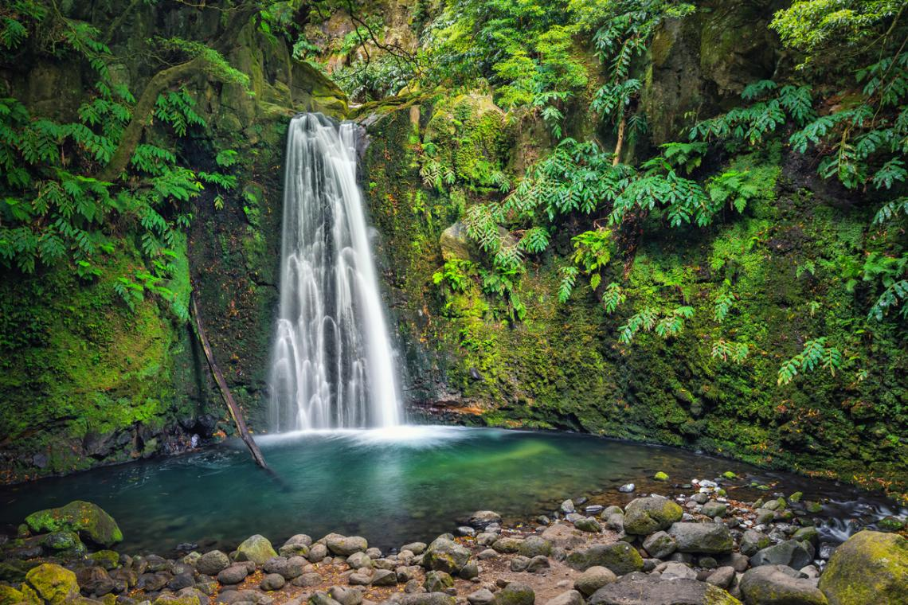
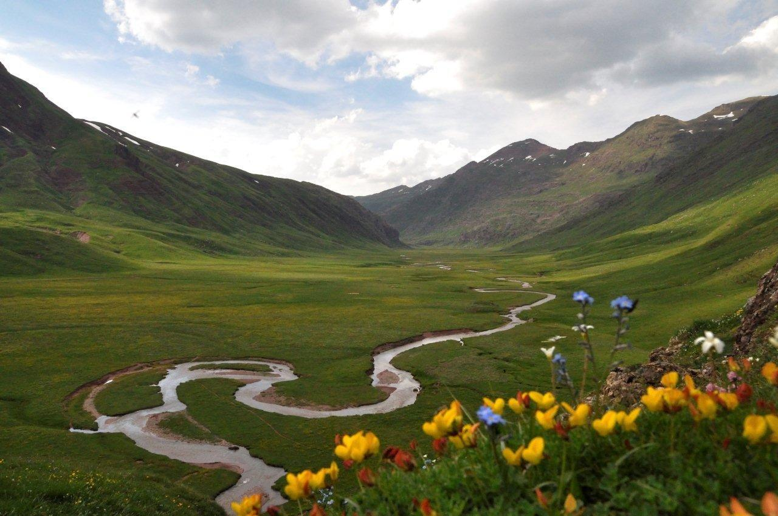
VOCABULARY: geography and landscape
Beach: playa | Canyon: cañón | Cliff: acantilado | Coast: costa | Desert: desierto | Island: isla | Lake: lago | Cave: cueva
Mountain: montaña | Ocean: océano | Reef: arrecife | River: río | Valley: valle | Waterfalls: cataratas | Forest: bosque

Slide 3
VOCABULARY: ANIMALS
Gorilla: gorila | Elephant: elefante | Cocodrile: cocodrilo | Owl: búho | Whale: ballena | Rhinoceros: rinoceronte | Polar bear: oso polar
Snake: serpiente | Turtle: tortuga | Butterfly: mariposa | Giraffe: girafa | Penguin: pingüino | Tiger: tigre | Bee: abeja

Slide 4
GRAMMAR: COMPARATIVE & SUPERLATIVE
adjective | comparative | superlative
fast | faster than | the fastest
hot | hotter than | the hottest
funny | funnier than | the funniest
expensive | more expensive than | the most expensive
good | better than | the best
bad | worse than | the worst
½ syllables + er
short
½ syllables –c/v/c = doble the consonant +er
-y, change –y → i + -er
long
more than ½ syllables + more...
irregular

Slide 5
GRAMMAR: A/AN, SOME, ANY
 | COUNTABLE |  | UNCOUNTABLE | (+) | (-) | (?)
 | SING. | PL.
A/AN
SOME
ANY
A: +consonant
An: +vowel

Slide 6
GRAMMAR: MUCH, MANY, A LOT OF
 | COUNTABLE |  | UNCOUNTABLE | (+) | (-) | (?)
 | SING. | PL.
A LOT OF
MANY
MUCH

Slide 7
GRAMMAR: AS...AS
as... as + adjective to compare things

Slide 8
LOOK!
CAPITAL LETTERS
The name of mountains, rivers, etc have a capital letter
ADJECTIVES TO DESCRIBE PLACES
beautiful, dangerous, amazing, unusual, boring, interesting...
THAN TO COMPARE THINGS
We use than to compare two things.

